Slide 1
The 4 Zones Model
Freeing IT’s future from the pull of its past
DevOps Enterprise Summit Keynote
October 13, 2020

Slide 2

A Tale of Two Stories at Microsoft

Slide 3

The Legacy Mindset About IT IT’s past
40-50% of CEOs and Boards still see IT as a cost center not a revenue generator
Less than 25% of companies are using digital technologies to advance their business strategy
IT spends 80% of its resources and budget on running the business and only 20% on changing the business

Slide 4
4 Zones Model: Business Value Creation Portfolio
Disruptive
Innovations
Sustaining Innovations
Transformation
Zone
Performance
Zone
Mission Critical
Scale material net new lines of business
Utilize digital technologies to enter adjacent markets
Develop & deploy systems of engagement to increase member experience value
Utilize systems of intelligence to better understand and deliver new member value
Incubation
Zone
Productivity
Zone
Enabling
Utilize Agile, Lean & DevOps to increase time to value
Identify, test & validate next generation products, services and new business ideas
Recover trapped value by consolidating, replacing or eliminating systems of record
Optimize SOR maintenance costs and reduce technical debt

Slide 5
4 Zones Model: Desired Outcomes
1. Higher percentage of IT resources & budget allocated to
change-the-business activities
2. Strong alignment between future IT investment priorities
and critical business outcomes
3. Significant increase in time-to-value and throughput for
all new product & service development projects
4. A culture that prioritizes progress over perfection

Slide 6
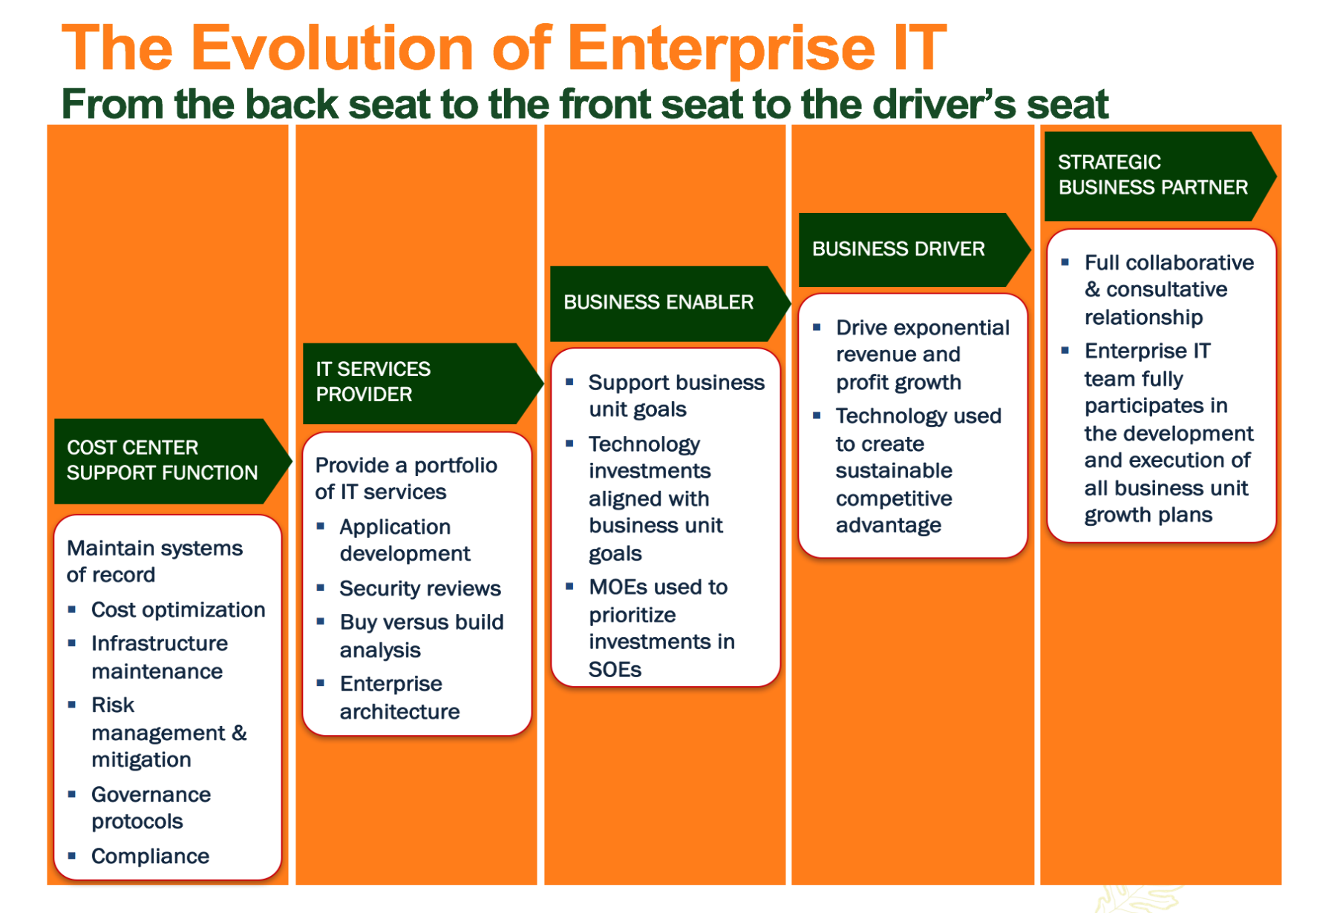
IT Maturity Model – Where Is IT in 2020? What’s already been done? What still needs to be done?

Slide 7
Getting Started: Step One IT Resource Allocation Assessment
Document allocation of all existing IT resources & budget into the 4 zones
% allocated to maintaining systems of record
Productivity Zone – Run the Business
% allocated to creating & deploying systems of engagement & systems of intelligence
Performance Zone – Change the Business
% allocated to identifying, testing and validating new technologies
Incubation Zone – Run & Change the Business
% allocated to new business or acquisitions
Transformation Zone – Change the Business

Slide 8
Getting Started: Step Two Trapped value recovery & redeployment exercise
Provide secure and stable IT infrastructure and insure all systems are in compliance with industry standards and regulations
Deploy the Trapped Value recovery process to optimize the costs of maintaining the company’s Systems of Record:
Modernize
Consolidate
Outsource
Retire
Identify and unlock trapped value in legacy systems that can be redeployed in Systems of Engagement and Systems of Intelligence

Slide 9

Trapped Value Recovery Some core questions to ask
Where is the trapped value in your company today?
How can you identify and unlock this trapped value?
Eliminate or consolidate Systems of Record
Replace Systems of Record
Simplify Systems of Record
Better leverage Systems of Record
How can you redeploy this trapped value against critical new digital investment priorities?
Where is the new value going to come from these new digital investments?

Slide 10
IT Business Value Creation IT’s future
How does IT create business value?
Does IT have the necessary skills and capabilities to deliver that value?
What could disrupt or dilute that value?
How can IT increase or enhance that value?

Slide 11

IT Maturity Model – Where Do We Want To Be in 2021? Who will lead this effort? When should it begin?

Slide 12
Getting Started: Step Three Trapped Value Redeployment: Investing in New Digital Technologies Core Question: To What End?
Future Tech
Company as a Service
Custom Apps
Platform as a Service
Analytics²
AI & Machine Learning
Social
Stakeholder Communities
Analytics¹
Systems of Intelligence
Mobile
Systems of Engagement
Cloud
Systems of Record

Slide 13
IT Investment Portfolio The Four Zones: Maximizing the Business Value of IT
Disruptive
Innovations
Sustaining Innovations
Transformation
Zone
Performance
Zone
Mission Critical
Disruptive Technology Investments
Acquisition Integration Investments
Customer Engagement Investments
Revenue Generation Investments
Incubation
Zone
Productivity
Zone
Enabling
Some questions to consider
Is the current weighting of IT investments by zone aligned with Corporate/Business Unit goals and priorities ?
Do we have the appropriate risk reward ratio across the IT investment portfolio?
Are we delivering the desired ROI from our portfolio of IT investments?
New Product Development Investments
Time to Market & Throughput Investments
IT Productivity Investments
Technical Debt Reductions

Slide 14
Getting Started: Step Four Building a new PMO process
Disruptive
Innovation
Sustaining
Innovation
TRANSFORMATION
ZONE
PERFORMANCE ZONE
Material
Revenues
BUS MODEL
OPER MODEL
PRODUCTIVITY
ZONE
Enabling
Investments
Staging Area
INFRA MODEL
INCUBATION
ZONE

Slide 15
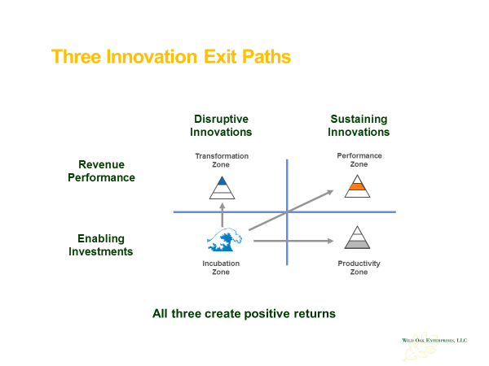
Project Prioritization Some core questions
Are they sustaining innovations or disruptive innovations?
Are they enabling systems productivity and cost optimization?
Are they increasing business unit performance and revenue growth?
Are they enabling business model transformation?

Slide 16
Demand Management Some core questions
Should we do it? Does it align with and support critical business outcomes?
Can we do it? Do we have the relevant skills, capabilities and capacity to achieve the outcome?
Did we do it? Do we have the right metrics to measure the achieved outcome vs. the desired outcome?

Slide 17
4 Zones Model: Business Value Creation Metrics Specific metrics for each zone
Transformation Zone
Performance Zone
Revenue hypergrowth
Win/loss ratio
Churn
Customer acquisition cost
Partner engagement
Bookings vs. plan
Revenue vs. plan
Contribution margins
Market share
Wallet share
Hypergrowth
Metrics
Investor
Metrics
Incubation Zone
Productivity Zone
10X performance advantage
Time to Value
Adoption & Utilization
User engagement
Category positioning
Cost optimization
Regulatory compliance
Technical debt reduction
Undesired attrition
Net Promoter Score
Venture
Metrics
Process
Metrics
Key Takeaway
Don’t use the metrics of one zone to measure the performance of another zone

Slide 18
Contact Information
Peter D. Moore
President
Wild Oak Enterprises LLC
310-395-2476
pdmoore@woellc.com

